Slide 1
OpenGL
Open Graphics Library

Slide 2
OpenGL
Specifications Not Implementation

Slide 3
History

Slide 4
OpenGL 1.0 (1992)
Basic Features for all Graphics Cards

Slide 5
OpenGL 1.0 (1992)
Want support for your graphics card feature?
Write Extensions!!!

Slide 6
OpenGL 1.1 (1997)
Texture Objects

Slide 7
What is Texture then?

Slide 8
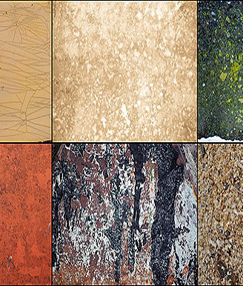
What is Texture then?

Slide 9
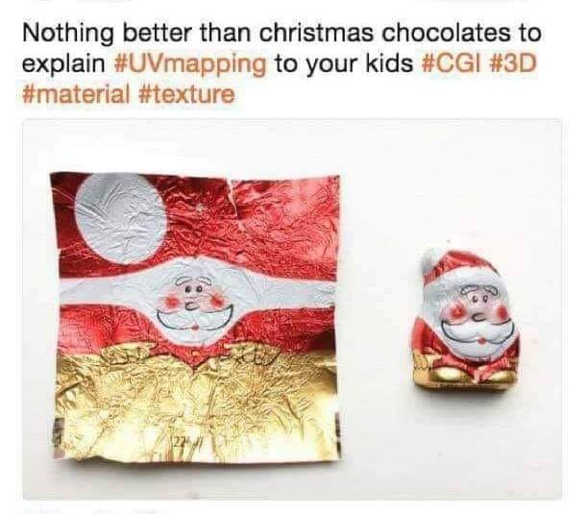
UV Mapping

Slide 10
OpenGL 1.2 (1998)
“Image Subset” for image processing

Slide 11
OpenGL 1.3 (2001)
More Texturing Features
Texture Compression
Multi-Sampling anti-aliasing
Multitexturing

Slide 12
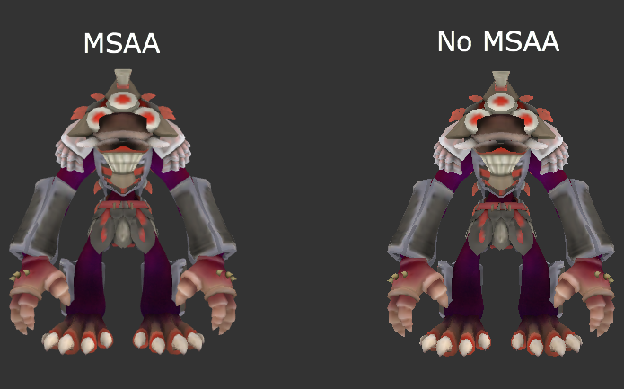
Multisampling

Slide 13
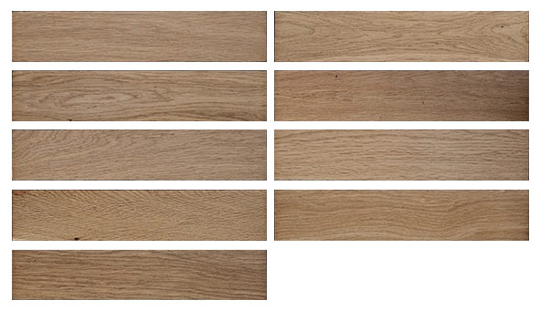
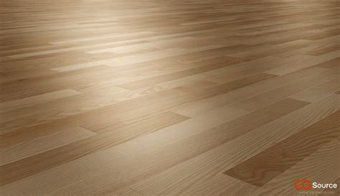
Multitexturing

Slide 14
OpenGL 1.5 (2003)
GLSL (OpenGL Shading Language)

Slide 15
OpenGL 2.0(2004)
C-like GLSL

Slide 16
OpenGL 3.0 (2008)
Deprecating Features
Fixed Function Pipeline
glBegin and glEnd

Slide 17
older <- 3.0 VS 3.1 -> newer
Traditional (Fixed 😞)
1. glBegin
2. Give data to GPU
3. glEnd
NEW! (programmable)
VAO & VBO
Vertex Shader!!!!
Fragment Shader!!!!
And So much Fun!

Slide 18
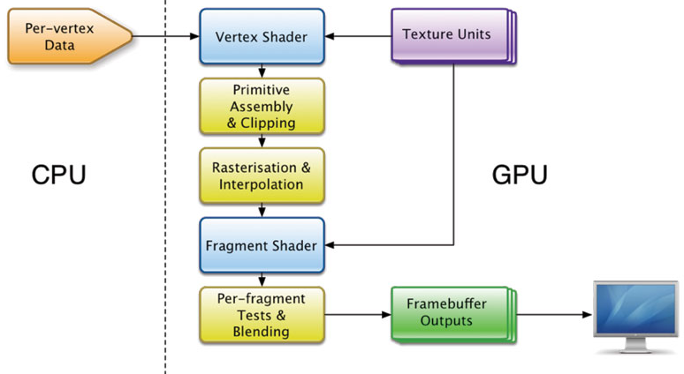
Graphics Rendering Pipeline

Slide 19
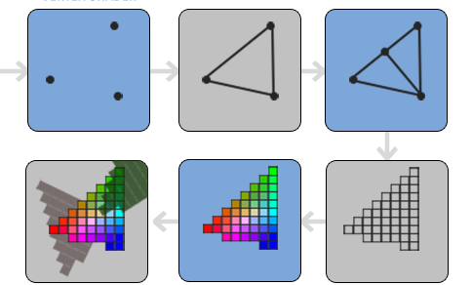
Graphics Rendering Pipeline
Vertex Shader
Shape Assembly
Geometry Shader
Vertex Data []
Test And Blending
Fragment Shader
Rasterization
Ref: https://learnopengl.com/Getting-started/Hello-Triangle

Slide 20
Demo Time!
https://www.shadertoy.com

Slide 21
Basic Shader Tutorial
https://thebookofshaders.com/

Slide 22
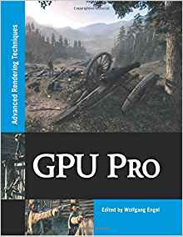
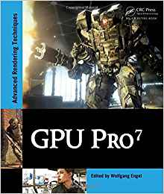
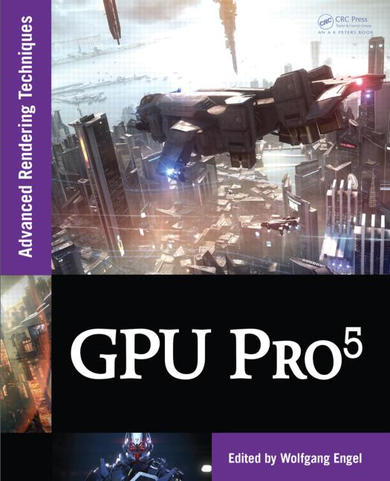
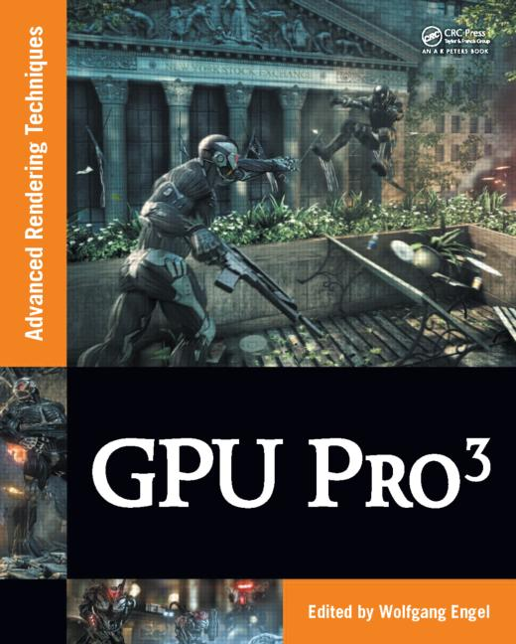
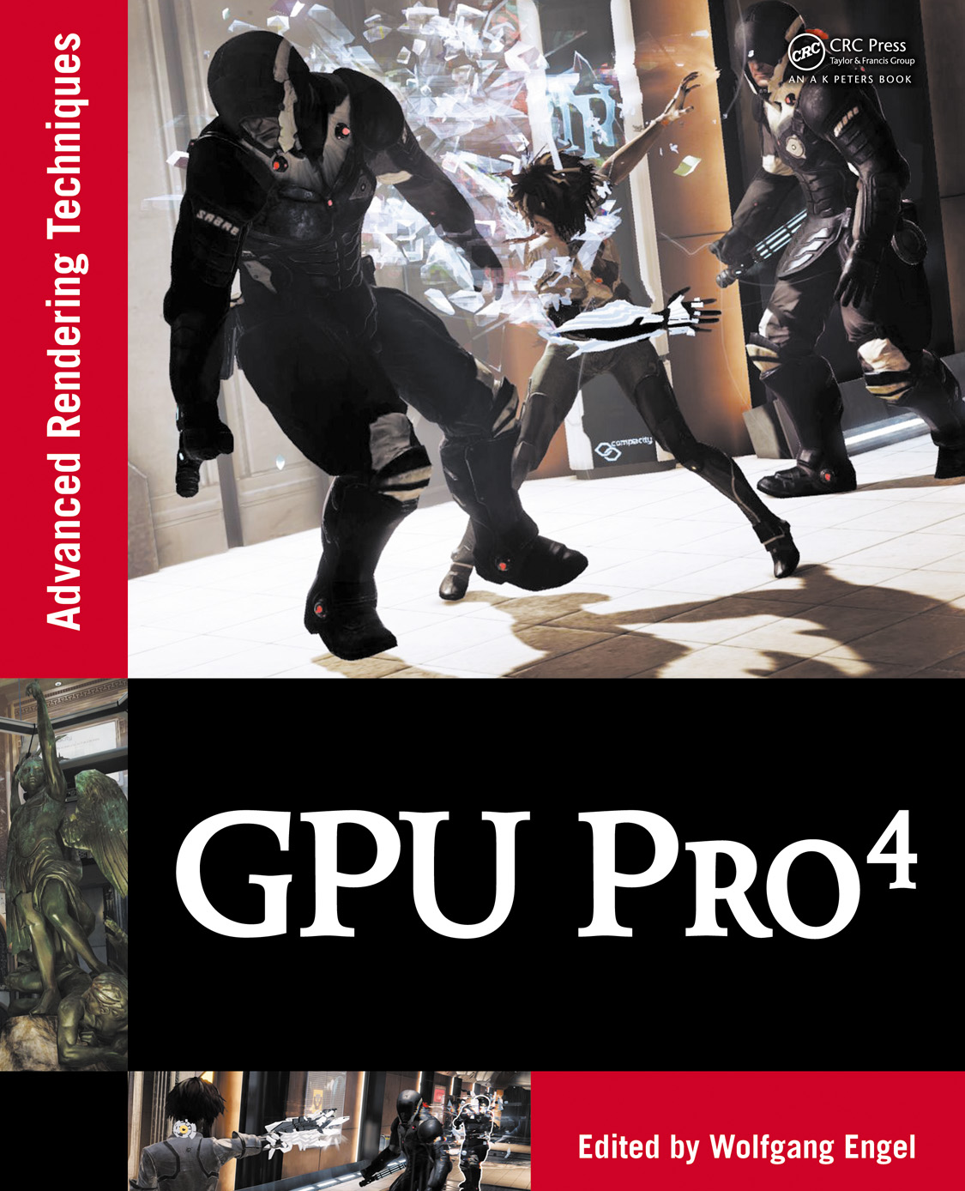
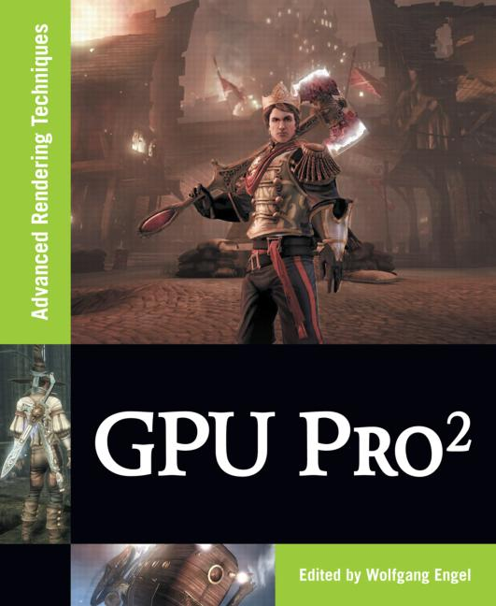
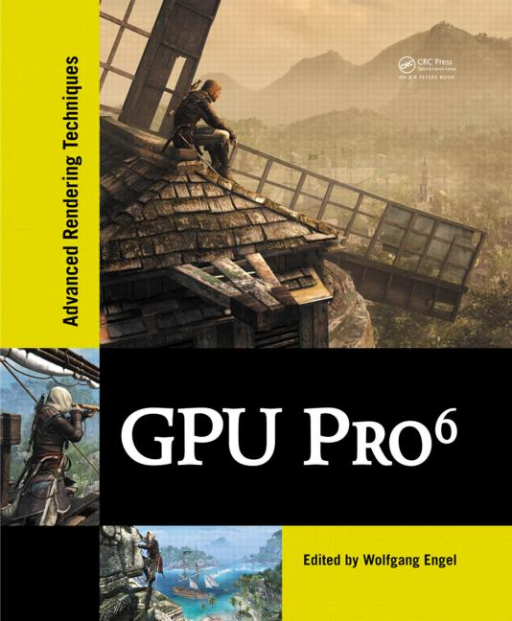
Are you book worm?
For Shaders!!

Slide 23
Not related to OpenGL
What is Mingw ?

Slide 24
Not related to OpenGL
What is Mingw ?
Minimalist GNU for Windows

Slide 25
Not related to OpenGL
What is Mingw ?
Minimalist GNU for Windows
Gnu is Not Unix

Slide 26
So I can only do OpenGL stuffs in Mingw(C/C++)?

Slide 27
Language Bindings for OpenGL
Ada
Common Lisp
C#
Delphi/Free Pascal (Object Pascal)
Fortran
FreeBASIC
Haskell
Visual Basic
Lua
https://www.khronos.org/opengl/wiki/Language_bindings

Slide 28
Language Bindings for OpenGL
OCaml
Perl
Pike
PowerBASIC
Python
Racket
Ruby
Java
https://www.khronos.org/opengl/wiki/Language_bindings

Slide 29
GUI Systems
Win32 (legacy)
QT Framework (has nice features)
GTK+
GLUT or FreeGLUT
GLFW and GLEW
SDL

Slide 30
What about Android and IOS?

Slide 31
OpenGL ES!!! ( GLES )

Slide 32
GLES 1.0 (2003)
It only supports Fixed Function Pipeline
Features are same as Desktop’s OpenGL 1.3

Slide 33
GLES 2.0 (2007)
Same features as Desktop’s OpenGL 2.0
But with Programmable Pipeline
Vertex Shader
Fragment Shader

Slide 34
GLES 3 (2012-2014-2015)
Acceleration for advanced visual effects
Ericsson Texture Compression (ETC2)
Enhanced Texturing
Easier to write portable applications
Geometry and Tessellation Shaders
Compute Shaders (GLES 3.1)
Single Codebase for all Platforms

Slide 35
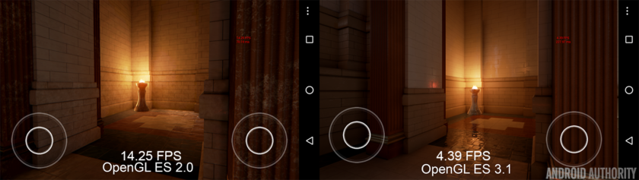
Which one is better?
GLES 2 VS GLES 3

Slide 36
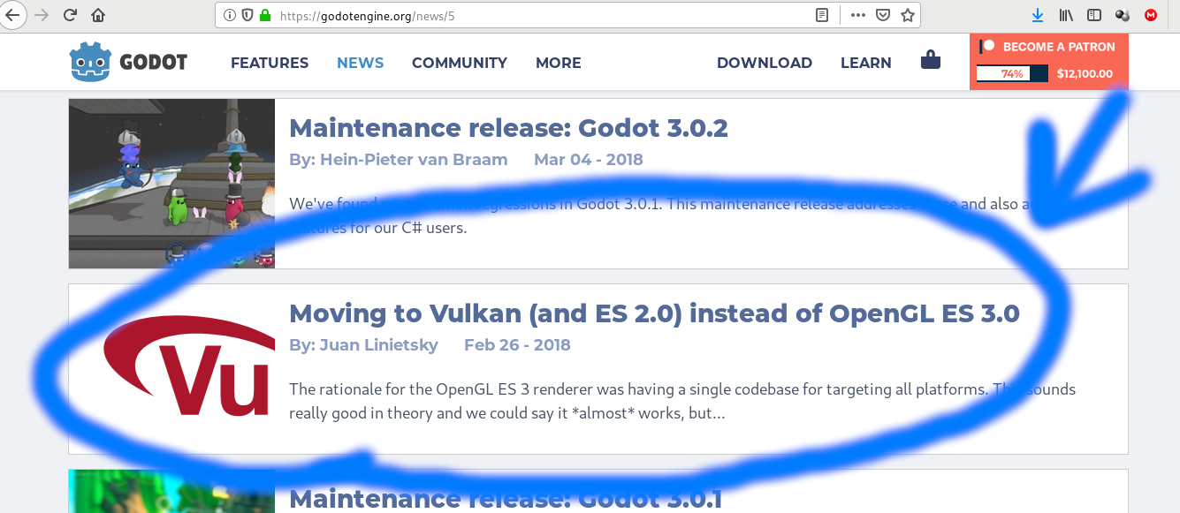
https://godotengine.org/article/abandoning-gles3-vulkan-and-gles2

Slide 37
GLES 3
Bad Implementations
Not Optimized
Poor mobile support (drivers)

Slide 38
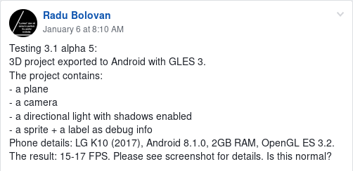
https://www.facebook.com/groups/godotengine/permalink/1455540687915854/

Slide 39
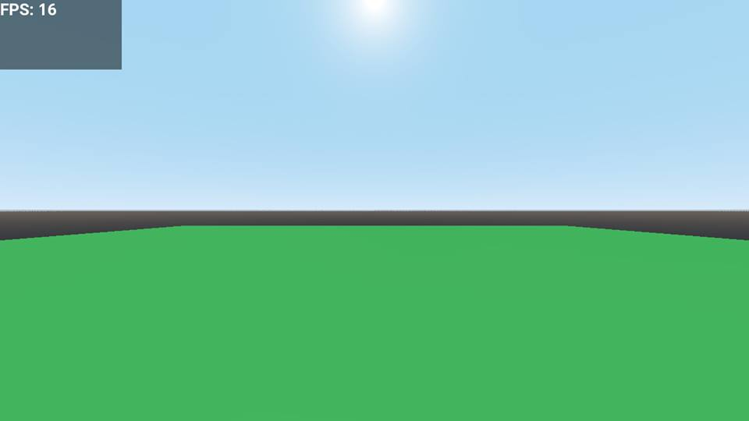

Slide 40
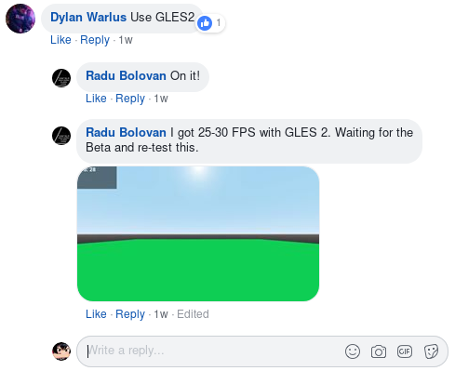
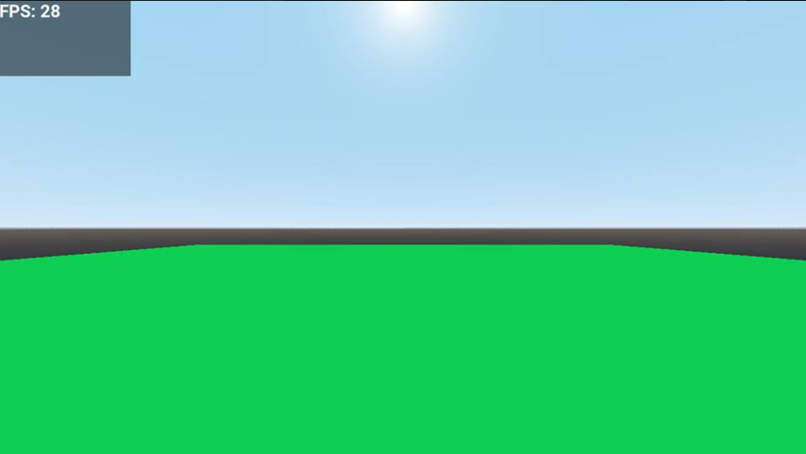
https://www.facebook.com/groups/godotengine/permalink/1455540687915854/

Slide 41
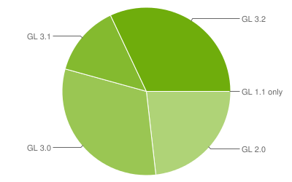
OpenGL ES for Android
https://developer.android.com/about/dashboards/#OpenGL

Slide 42
OpenGL ES 3.* for Android
Supported but barely runnable
Can be run only on a handful of high-end devices.

Slide 43
Alternatives To OpenGL
DirectX (Only Windows and Xbox…. Not really)
https://store.steampowered.com/linux
https://store.steampowered.com/steamos
Metal (Apple)
Vulkan (new)

Slide 44
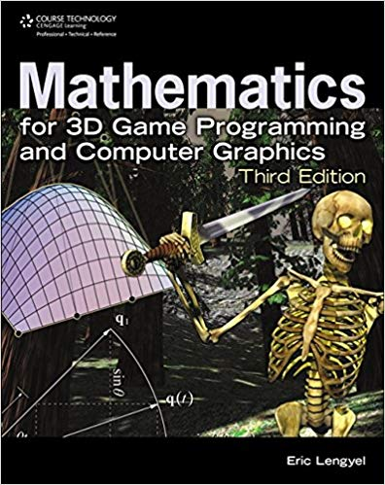
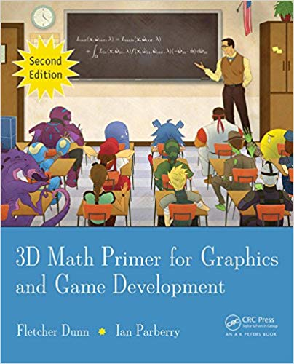
Are you book worm?
Beginner

Slide 45
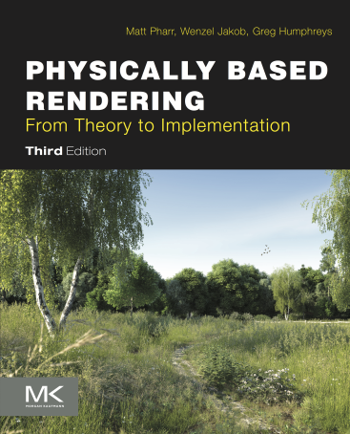

Are you book worm?
Advanced!!

Slide 46
We are …..
Satt Paing Phyoe
Si Thu Myo
Lin Htet Moe
Khant Myat Min
Phone Pyae Kyaw
Tun Nanda Aung
Myat Kaung Khant

Slide 47
Thanks
Now go make some cool stuffs

Slide 48
And also WebGL and WebGL 2.0
https://github.com/sithumyo1998/Uni-Presentations

